Slide 1

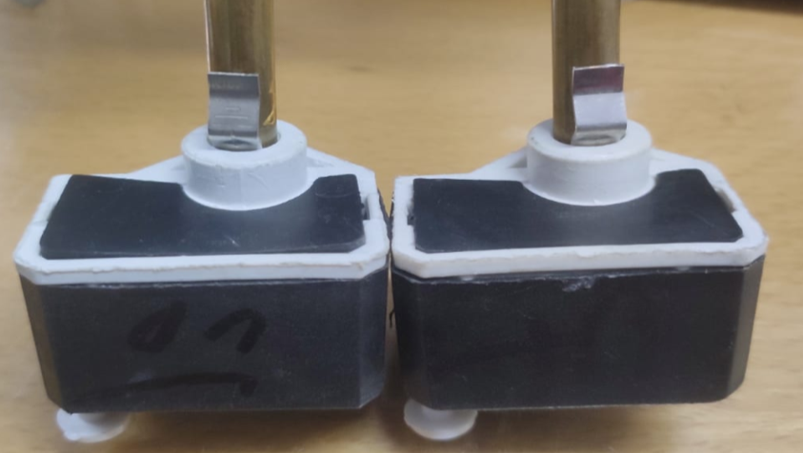
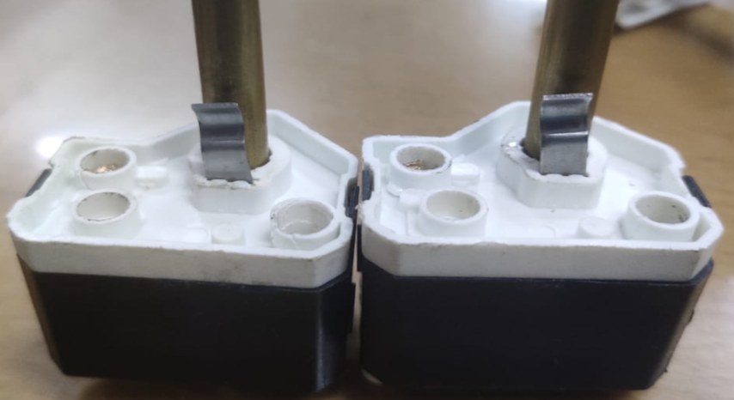
Face major Problem in 7” Stem Type Cutout
Date:- 21.07.2021
OK
NG
Photo
Photo
Appearance:- Cutout Clip should not be loose & free from burr etc.
Observation:- Find Loose and also attach video and photo
PREPARED BY:-VIJAY KUSHWAHA
APPROVED BY:-KUMAR SAURABH

Slide 2
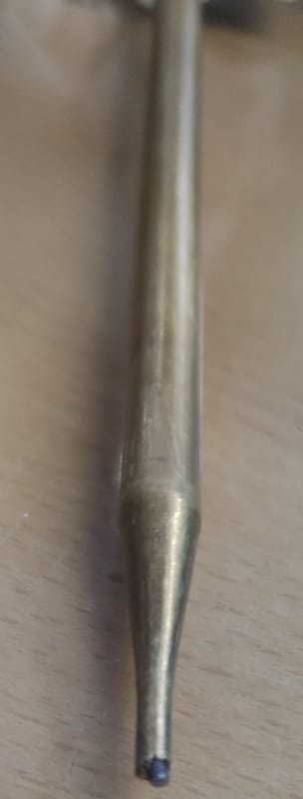
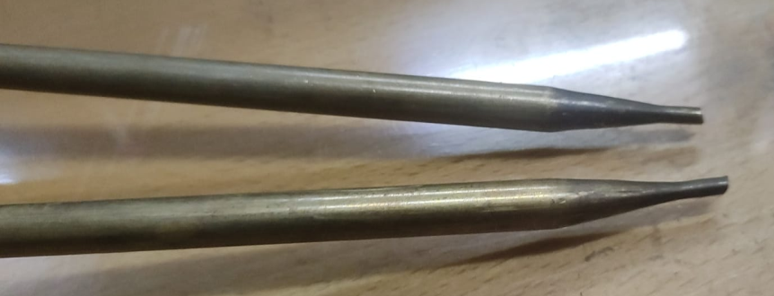
Face major Problem in 7” Stem Type Cutout
Date:- 21.07.2021
OK
NG
Photo
Photo
Appearance:- Cutout Pin or Nib Edge should be free from burr & Roughness etc.
Observation:- Find Burr and Roughness.
PREPARED BY:-VIJAY KUSHWAHA
APPROVED BY:-KUMAR SAURABH

Slide 3
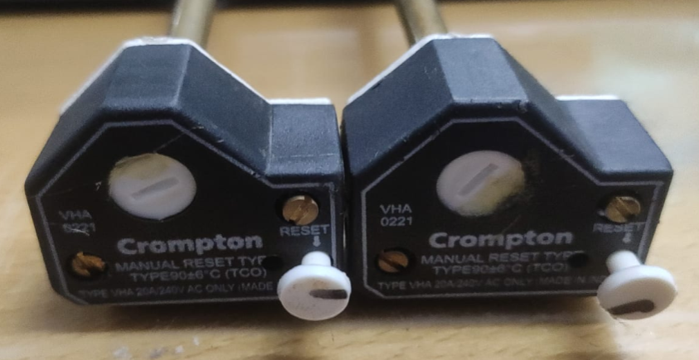
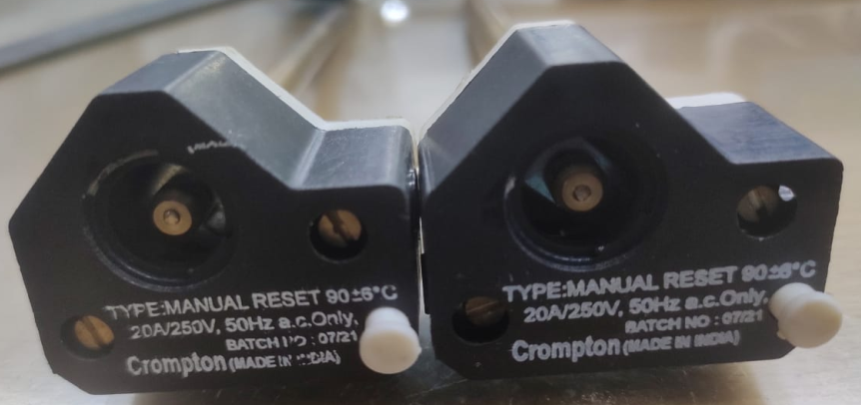
Face major Problem in 7” Stem Type Cutout
Date:- 21.07.2021
OK
NG
Photo
Photo
Appearance:- Cap should fit easily and tight (not out from the cutout).
Observation:- Cap out easily from Cutout.
PREPARED BY:-VIJAY KUSHWAHA
APPROVED BY:-KUMAR SAURABH

Slide 4
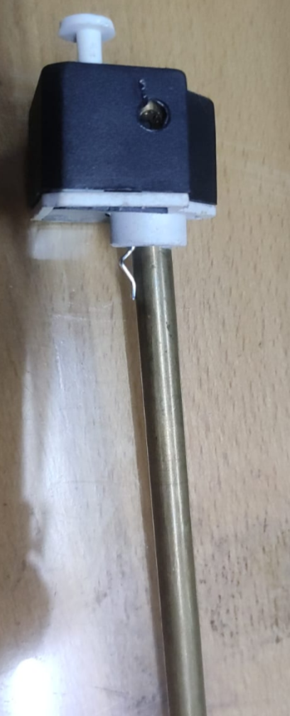
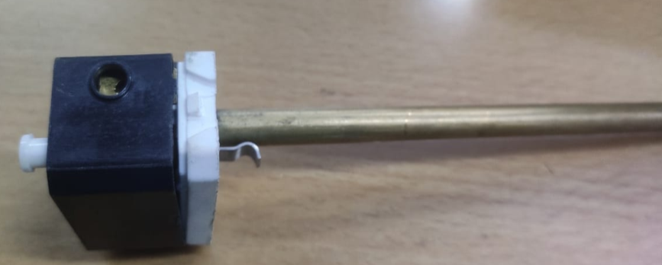
Face major Problem in 7” Stem Type Cutout
Date:- 21.07.2021
OK
NG
Photo
Photo
Appearance:- Cutout Body lock should be proper fixed, Gap & broken not allowed.
Observation:- Find Lock broken
PREPARED BY:-VIJAY KUSHWAHA
APPROVED BY:-KUMAR SAURABH

Slide 5
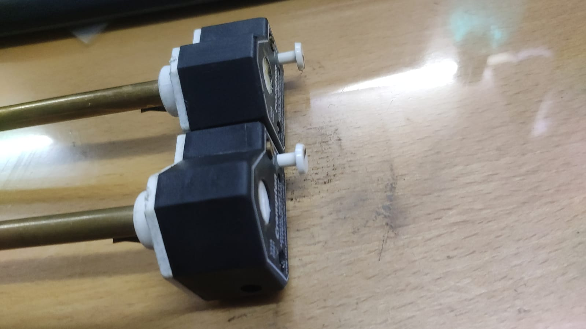
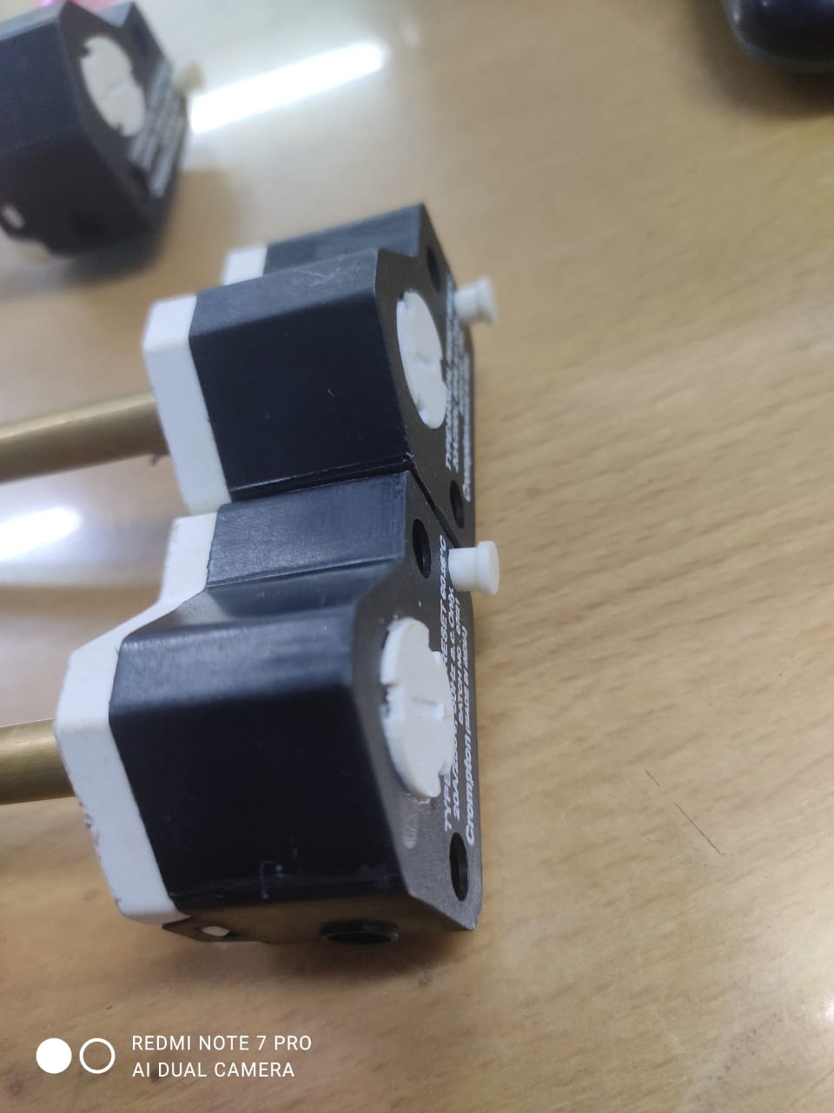
Face major Problem in 7” Stem Type Cutout
Date:- 21.07.2021
OK
NG
Photo
Photo
Appearance:- Cap should be match with body .(Cap fitted under the body)
Observation:- Find Mismatch from the body. (Cap not fitted under the body)
PREPARED BY:-VIJAY KUSHWAHA
APPROVED BY:-KUMAR SAURABH

Slide 6
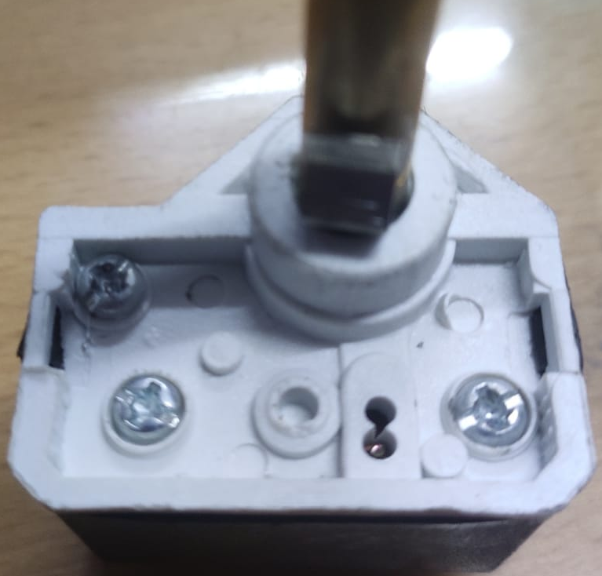
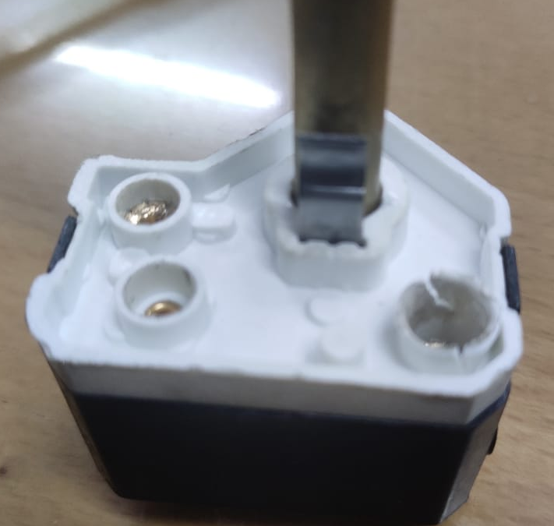
Face major Problem in 7” Stem Type Cutout
Date:- 21.07.2021
OK
NG
Photo
Photo
Appearance:- After Bushing & Screw of molding part free from damage.
Observation:- Find molding part damage
PREPARED BY:-VIJAY KUSHWAHA
APPROVED BY:-KUMAR SAURABH

Slide 7
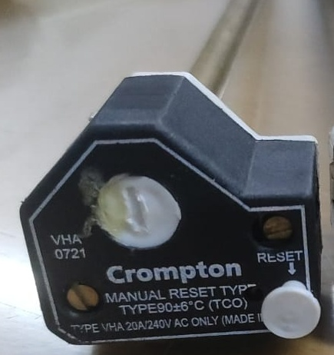
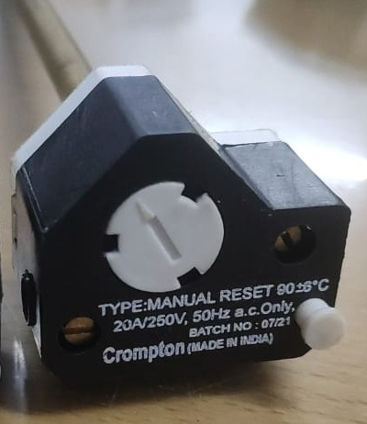
Face major Problem in 7” Stem Type Cutout
Date:- 21.07.2021
OK
NG
Photo
Photo
Appearance:- Cutout Printing details, printing font & size same as sample
Observation:- Find other font and Size.
PREPARED BY:-VIJAY KUSHWAHA
APPROVED BY:-KUMAR SAURABH

Slide 8
Details of cutout Rejection
Date:- 21.07.2021
Total Qty/Size:- 350 Nos
Check Qty/Size:-250 Nos
Ok Qty:-150 Nos
Low Qty :-29
High Qty:-42
Visual Qty:-29(All Photo Attached already in this PPT)
PREPARED BY:-VIJAY KUSHWAHA
APPROVED BY:-KUMAR SAURABH

